Slide 1
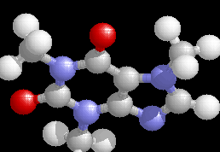
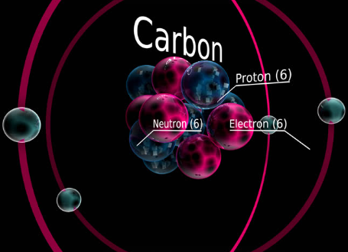
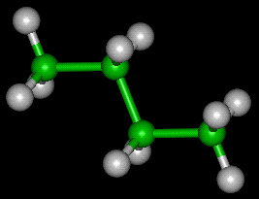
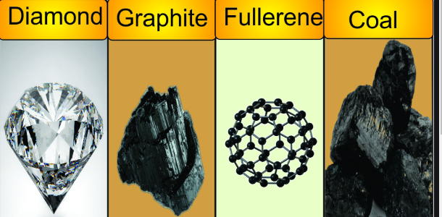
CARBON AND ITS COMPOUNDS

Slide 2
VERSATILE NATURE OF CARBON
Tetravalency: Tetra means four and valency means the number of electrons gained or lost or shared to attain stable configuration. So, tetravalency refers to the phenomenon of sharing four electrons by an element to attain stable condition. Now, the electronic configuration of carbon is 2, 4. It shares four electrons with other elements to attain a stable configuration.
Catenation: This is a property of self-linking. This property depends on size of atom which will decide the M-M bond strength. This property is more unique for carbon as more than thousand atoms of carbon can be linked.

Slide 3
COVALENT NATURE OF CARBON
Carbon has atomic number 6.
Electronic configuration is ( 2,4).
Like every atom carbon atom also tries to complete it's octet (fill it's outermost shell with 8 electrons).
Carbon has to either gain four electrons or lose four electrons.
When it will gain four electrons it will acquire four negative charges and become C-4 . C-4 is very unstable as negatively charged carbon repels extra electrons .
when it loses four electrons and become C+4 , needs a great deal of energy and 6 protons could not deal with 10 electrons. As these two forms are very unstable and requires much energy carbon completes it's octet by sharing electrons with other atoms (forming covalent bonds). As a result carbon has unique capacity of forming chains and branches.

Slide 4
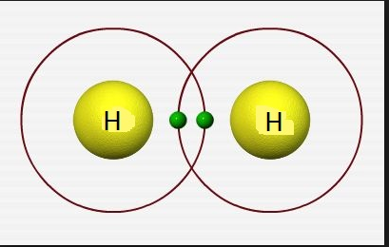
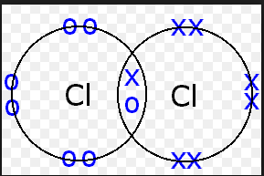
SINGLE COVALENT BOND

Slide 5
SINGLE COVALENT BOND IN CARBON COMPOUND

Slide 6
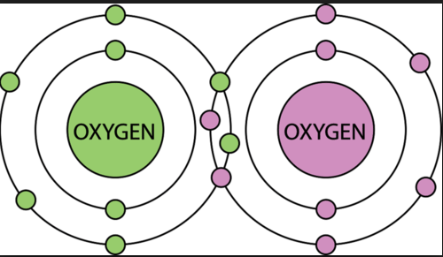
DOUNBLE COVALENT BOND

Slide 7
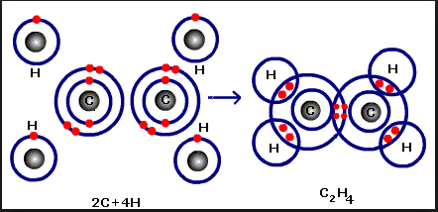
DOUNBLE COVALENT BOND IN CARBON COMPOUND

Slide 8
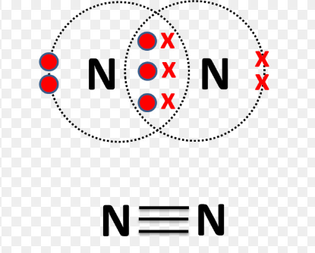
TRIPLE COVALENT BOND

Slide 9
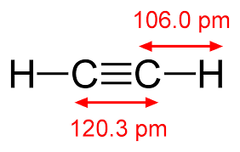
TRIPLE COVALENT BOND IN CARBON COMPOUND

Slide 10
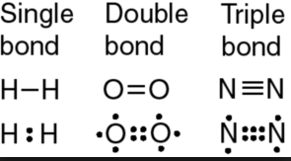
TYPES OF COVALENT BOND

